Slide 1
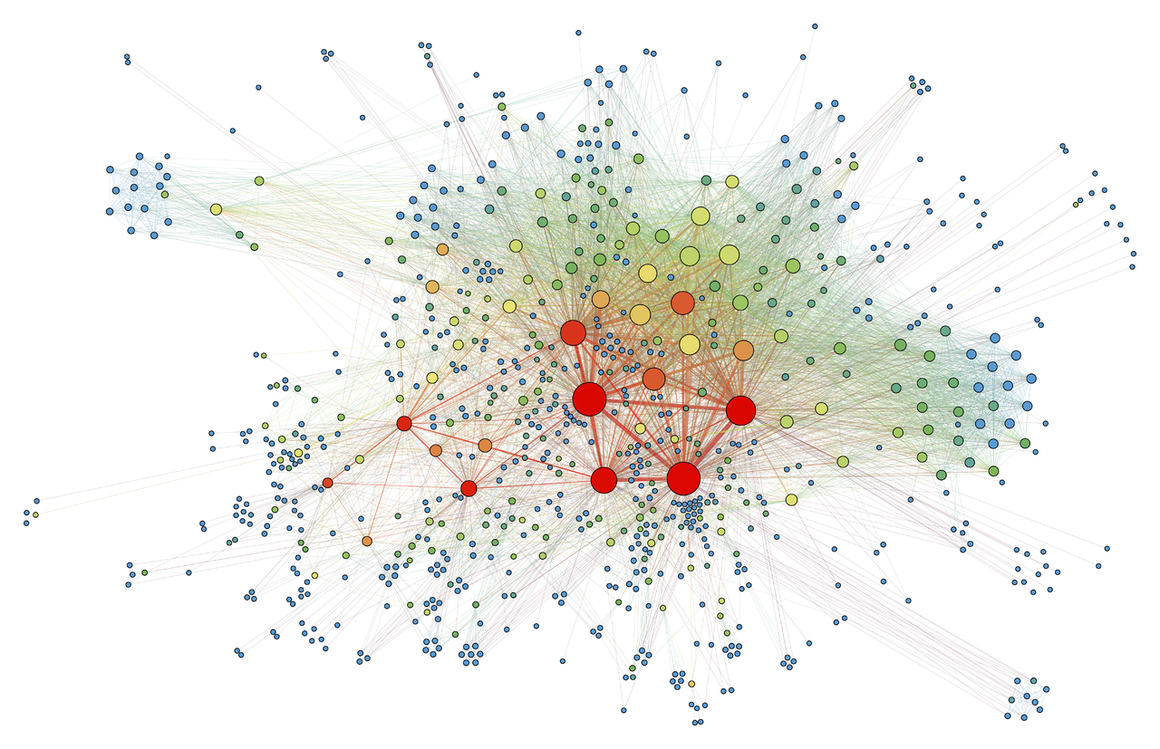
Graph Databases
COMP / IT 420 Lecture 12
April 19th, 2021

Slide 2
Updates and Reminders
Homework 4 Concurrency is due tomorrow night, Tuesday, April 20th
Lab this week will be mostly focused on project feedback. This will consist of individual team meetings to talk through your design docs.

Slide 3
Updates and Reminders
The last (optional) homework assignment will be released on Wednesday. It can be completed up until the end of the semester on Sunday May 16th, 2021.
It mainly focuses on more advanced problems with both Mongo and Neo4j.

Slide 4
Today’s Menu
Graph Database Basics and Terminology
Neo4j and the Cypher Graph Query Language (GQL)
Graphs and Relational Modeling
Graph Modeling Basics

Slide 5
Graph Database
Uses graph structures for semantic queries with nodes, edges and properties to represent and store data.
Based on property-graph model:
Nodes represent entities.
Properties are characteristics of nodes.
Edges connect nodes and represent relationships.
Important information is mostly stored in the edges.
Patterns emerge in examining the interconnections of nodes, properties, and edges.

Slide 6
Graph Database Terminology
Native graph storage
Underlying system stores data in graph structures on disk
Index-free adjacency
Traversing native graph storage allows for immediate linking between adjacent nodes, no intermediary management needed
Native graph processing
Graph databases that support index-free adjacency

Slide 7
Why Graph Databases?
Easy to model specific kinds of connected data
Very fast processing and computation on graph-like structures
Social network and semantic web data are used in many different industries so there is significant appeal
Graph processing in non-native environment requires significant work as naïve methods are generally intractable at medium-to-large scale

Slide 8
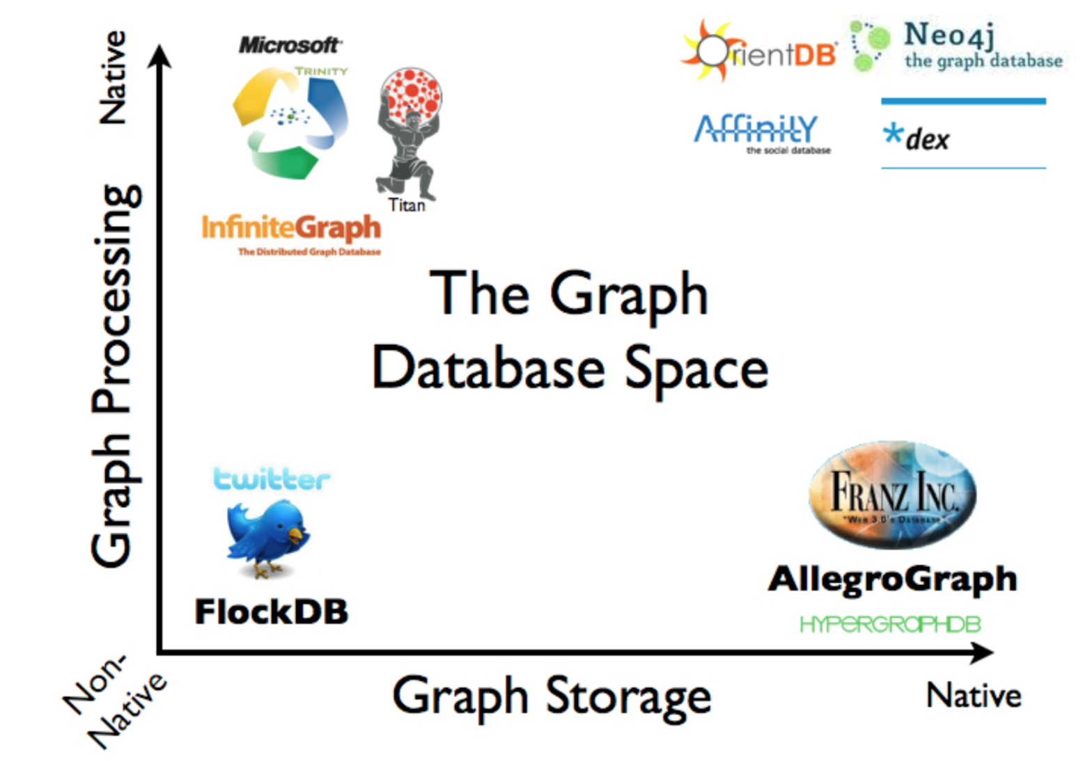

Slide 9
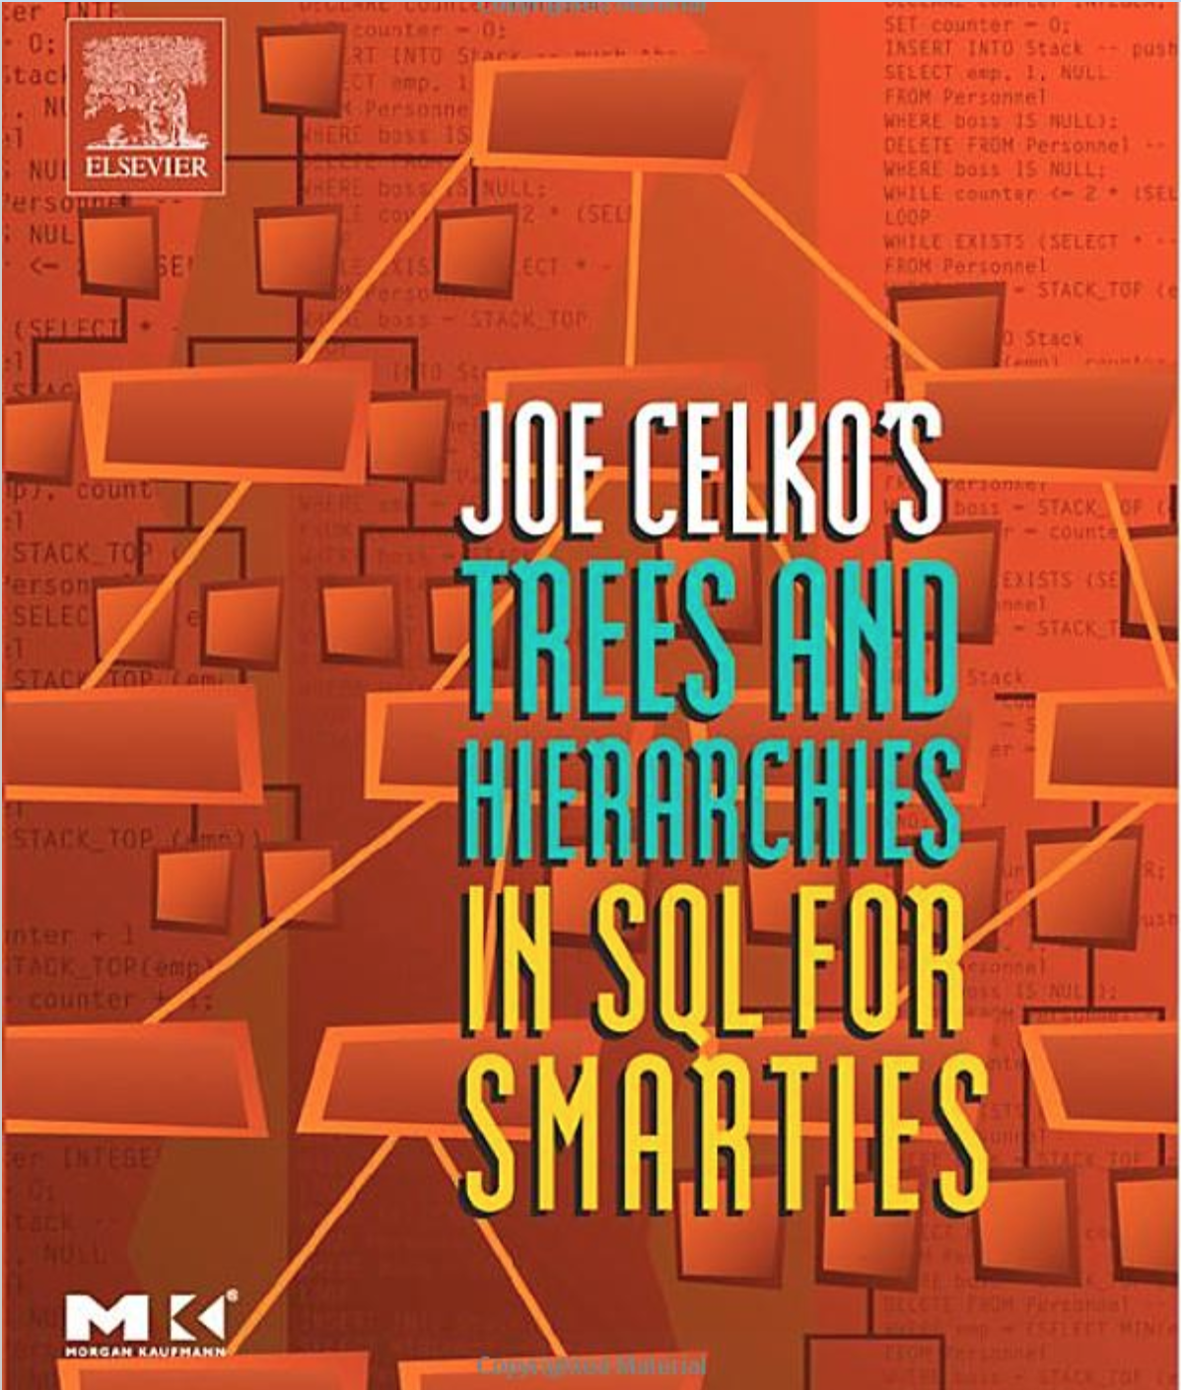

Slide 11
Neo4j
Labeled property graph is the basic data organization structure
Nodes contain properties (key-value pairs)
Nodes can be labeled with one or more labels
Relationships are named and directed (asymmetric)
Relationships can also contain properties

Slide 12
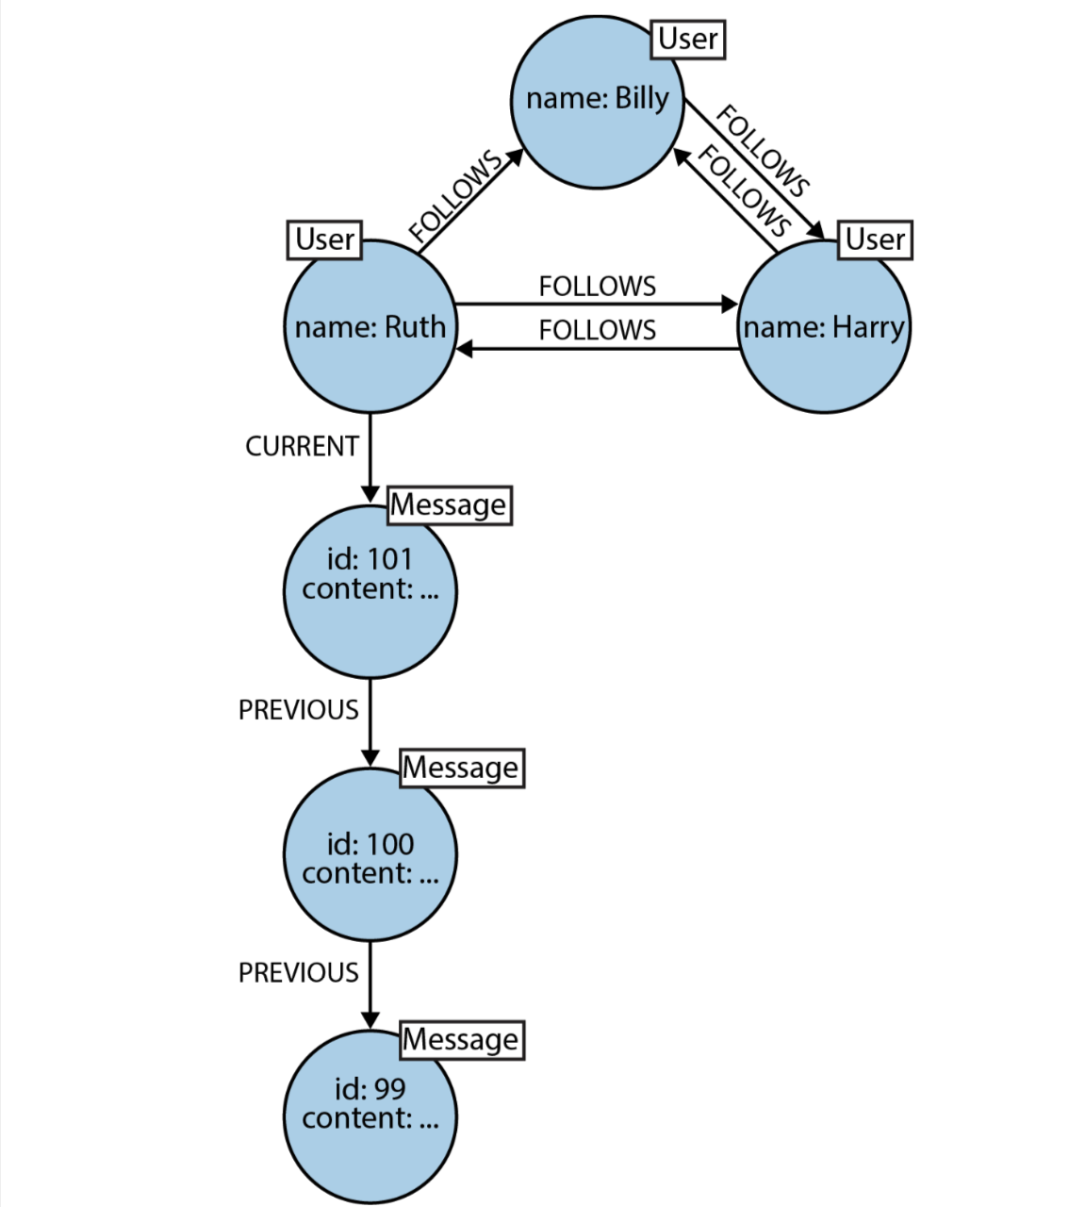
Edge label
timestamp: “2020-04-27”
Node label
Relationship
property
Directional
Ruth and Harry follow each other, Ruth only follows Billy
Node property

Slide 13
Neo4j
Schema-less, no internal enforcement of labeling or structure
One database for all graphs. If there are no relationships then nodes will not be traversed.
Uses Cypher Graph Query Language (GQL) to run queries.

Slide 14
Graph Modeling
Instead of translating graph-like connections into RDBMS or document stores, just embed the graph directly
Logical and physical model are very similar in native graph stores. This is good if you are wanting to work exclusively with graph-like data.
This is not good if you are trying to model other forms of data that are more conducive to lists, documents or that do not have lots of relationships.

Slide 15
Cypher GQL
Declarative Graph Querying Language (GQL)
DML for graph databases
Great for complex relationship queries that elude other DML languages
Immediate application of graph algorithms and search without translation

Slide 16
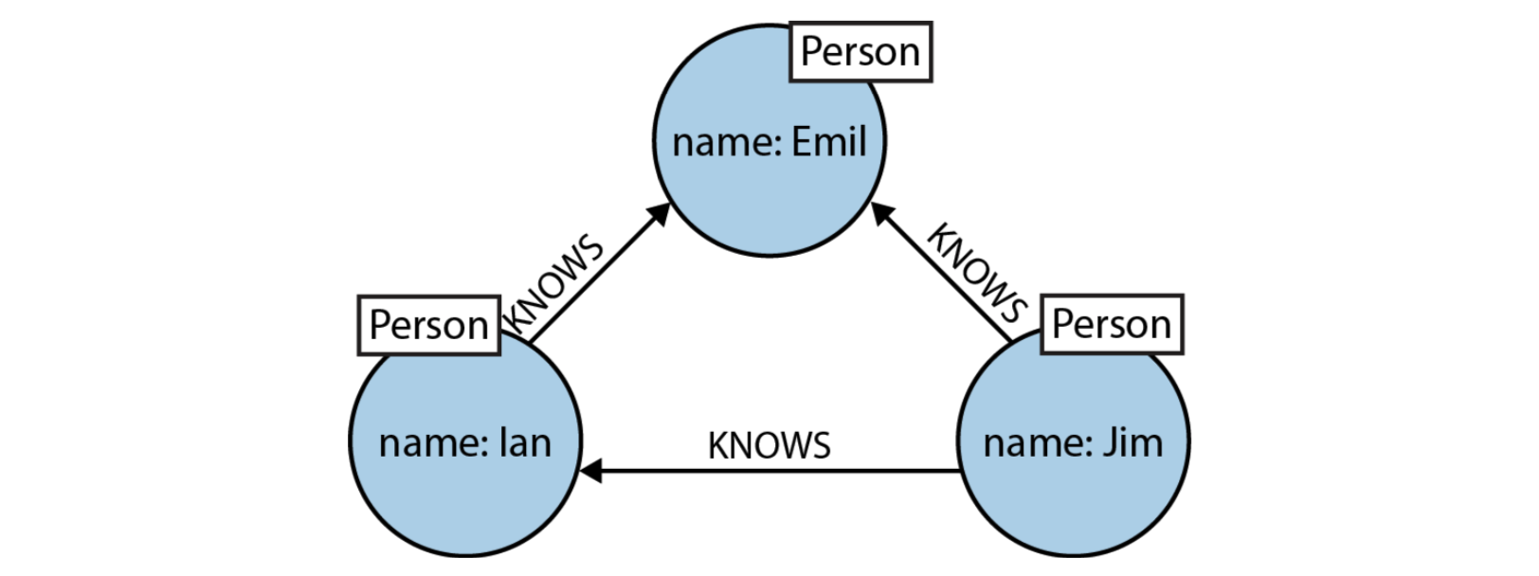
Specification by Example
(emil)<-[:KNOWS]-(jim)-[:KNOWS]->(ian)-[:KNOWS]->(emil)
(emil:Person {name:”Emil”})<-[:KNOWS]-(jim:Person {name:”Jim”})
-[:KNOWS]->(ian:Person {name:”ian”})-[:KNOWS]->(emil)

Slide 17
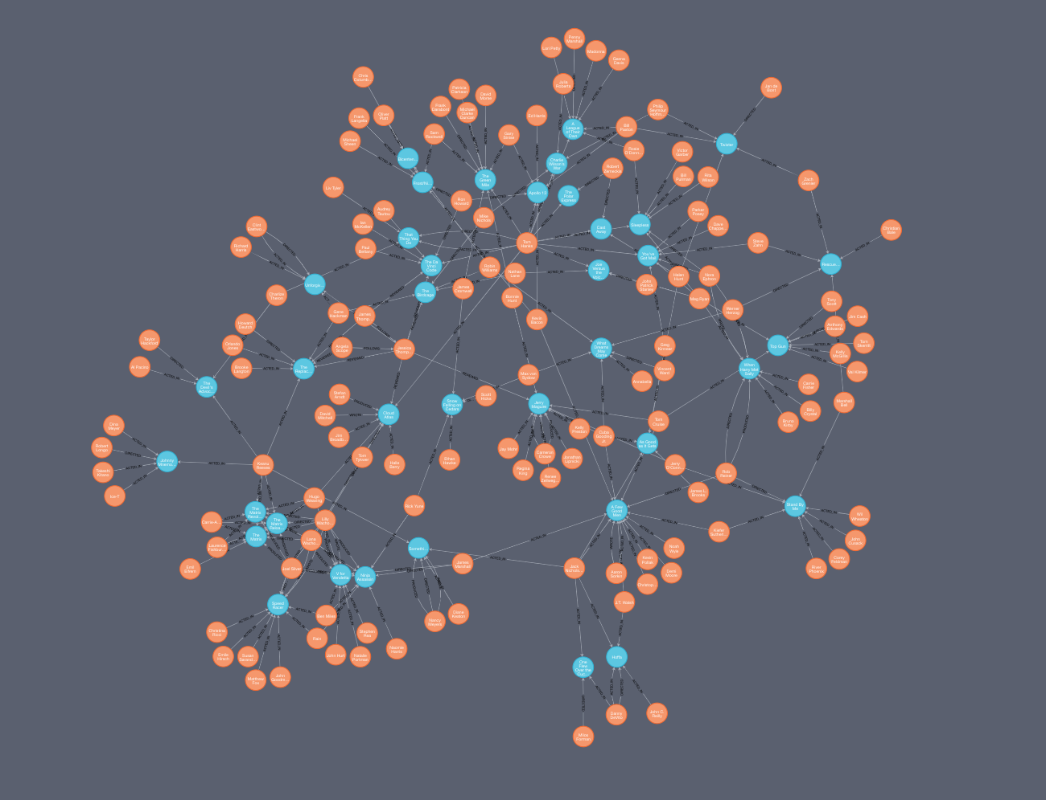
Example Movie Graph

Slide 18
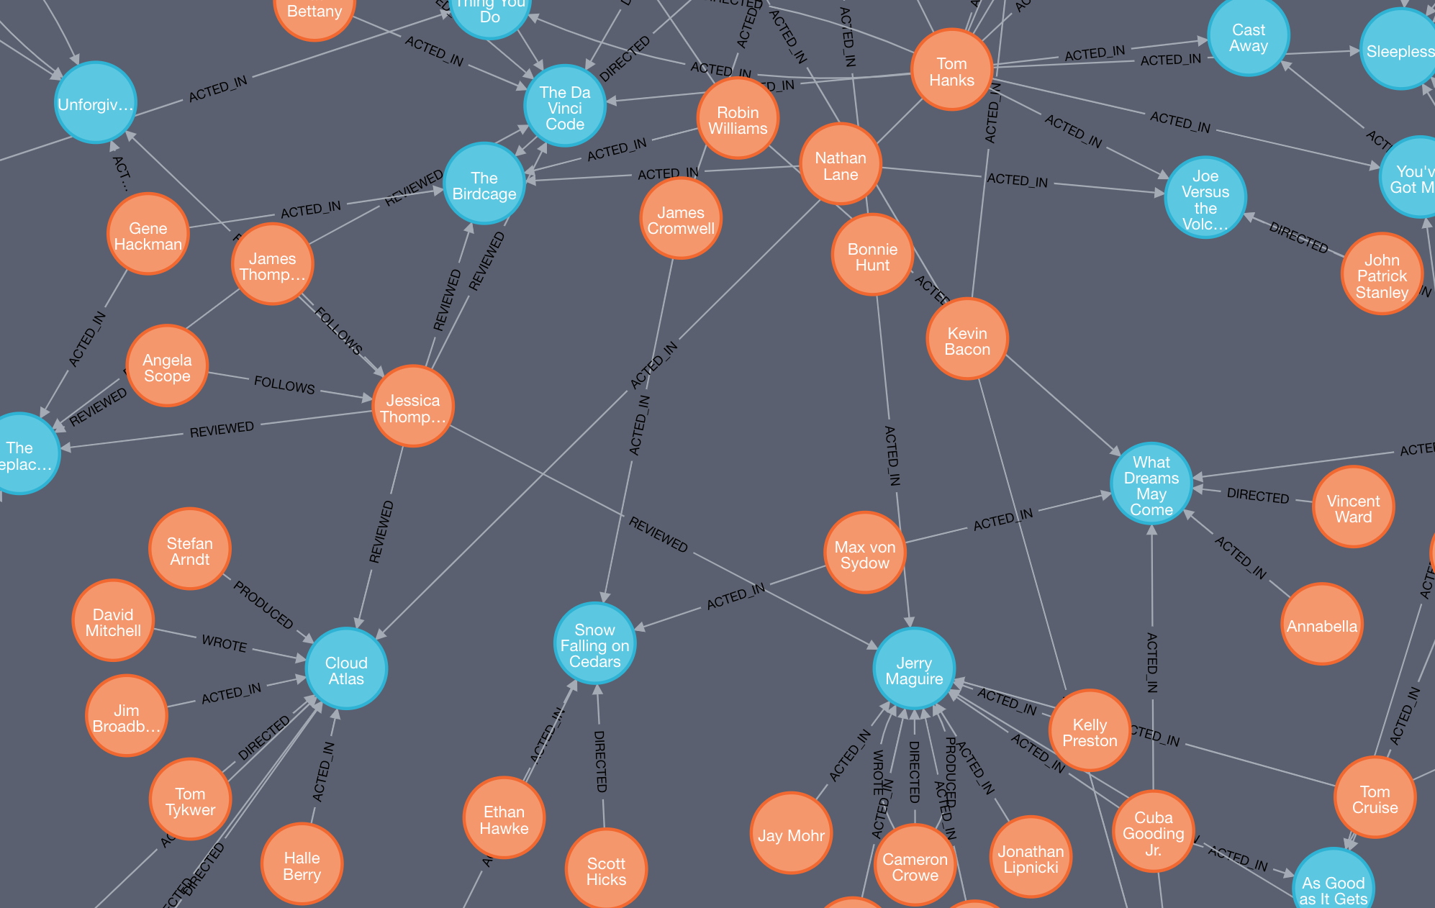

Slide 19
match (n) return n

Slide 20
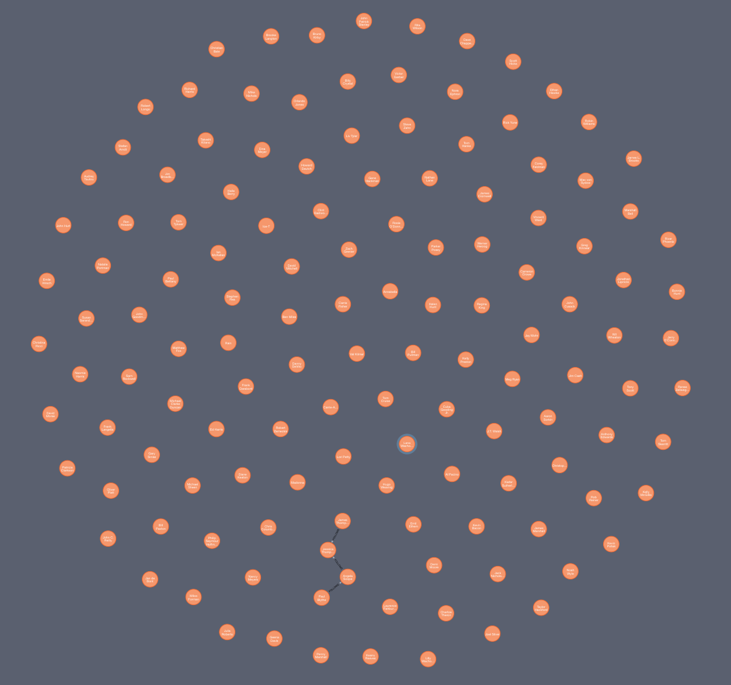
match(p:Person) return p

Slide 21
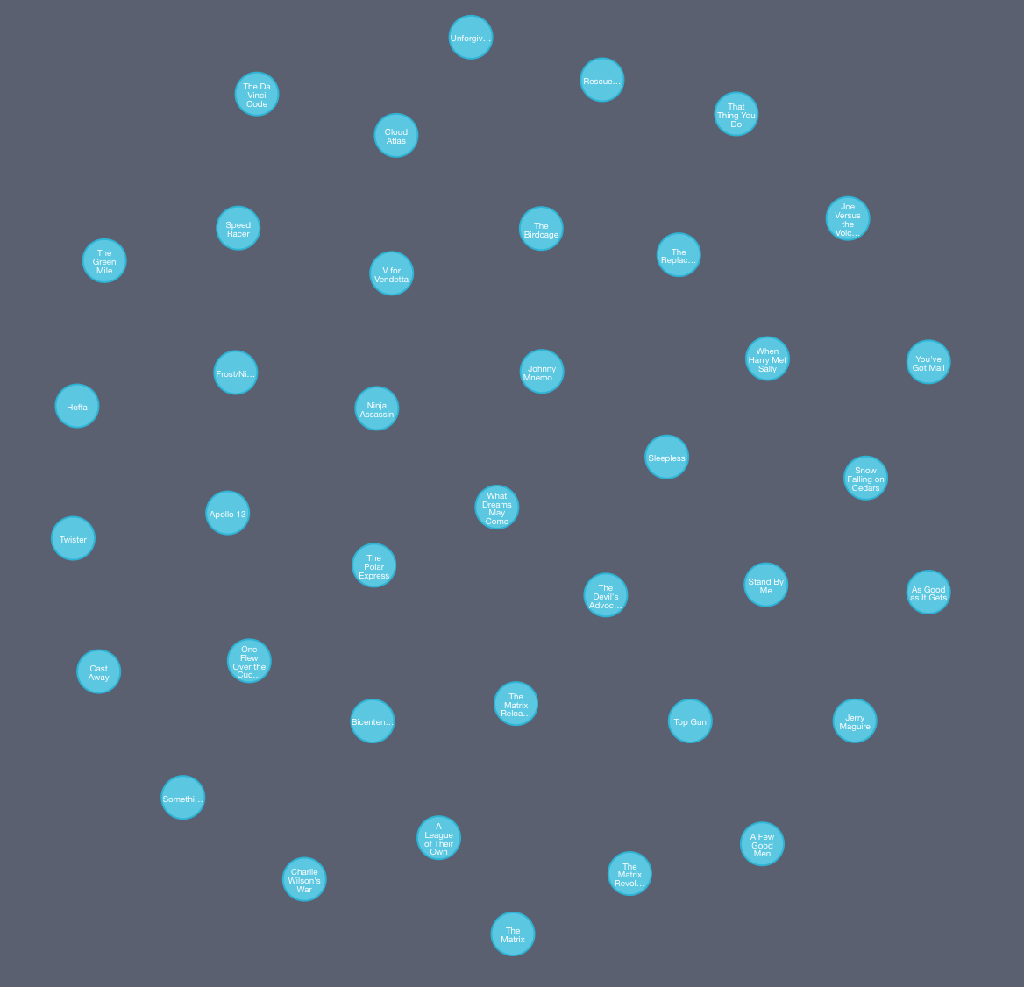
match(m:Movie) return m

Slide 22

match(tom {name: “Tom Hanks”}) return tom

Slide 23
match(tom {name: “Tom Hanks”}) return tom
”tom” is anchored to a specific set of nodes, those with name = “Tom Hanks”
In this case, there is only one Tom Hanks (as there should be, national treasure).
This node is “bound” to the name “tom”.

Slide 24
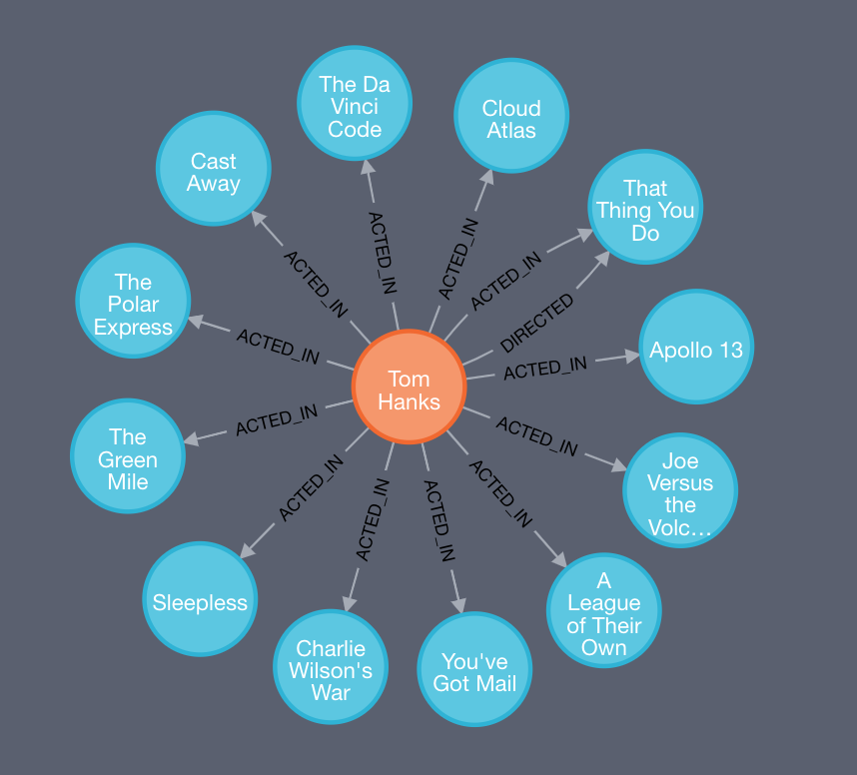
match(tom {name: “Tom Hanks”})--(m) return tom,m
”any” relationship of “any” length

Slide 25
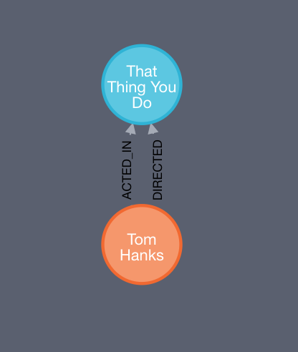
match(tom {name: “Tom Hanks”})-[:DIRECTED]->(m) return tom, m

Slide 26
match(tom {name: “Tom Hanks”})-[:DIRECTED]->(m) return tom, m

Slide 27
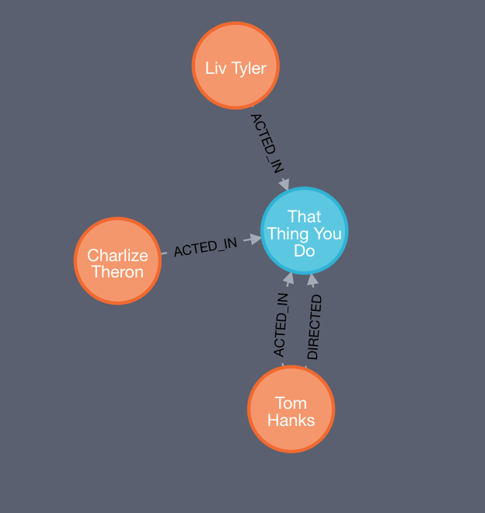
match(tom {name: “Tom Hanks”})-[:DIRECTED]->(m)<-[:ACTED_IN]-(p:Person) return tom, m, p

Slide 28
match(tom {name: “Tom Hanks”})-[:DIRECTED]->(m)<-[:ACTED_IN]-(p:Person) return tom, m, p

Slide 29
match(tom {name: “Tom Hanks”})

Slide 30
-[:DIRECTED]->(m)<-[:ACTED_IN]-(p:Person)
match(tom {name: “Tom Hanks”})
typed
directed
edge
generic
node
typed
directed
edge
typed
node

Slide 31
-[:DIRECTED]->(m)<-[:ACTED_IN]-(p:Person)
match(tom {name: “Tom Hanks”})
return tom, m, p

Slide 32
match(tom {name: “Tom Hanks”})-[:DIRECTED]->()<-[:ACTED_IN]-(p:Person) return tom, p
anonymous node
we don’t care about it specifically,
but want to use it to find other node

Slide 33
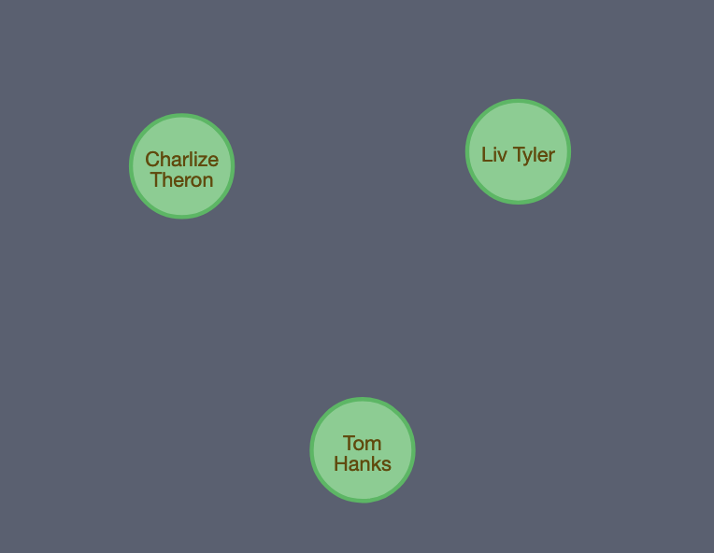
match(tom {name: “Tom Hanks”})-[:DIRECTED]->()<-[:ACTED_IN]-(p:Person) return tom, p
anonymous node
we don’t care about it specifically,
but want to use it to find other node

Slide 34
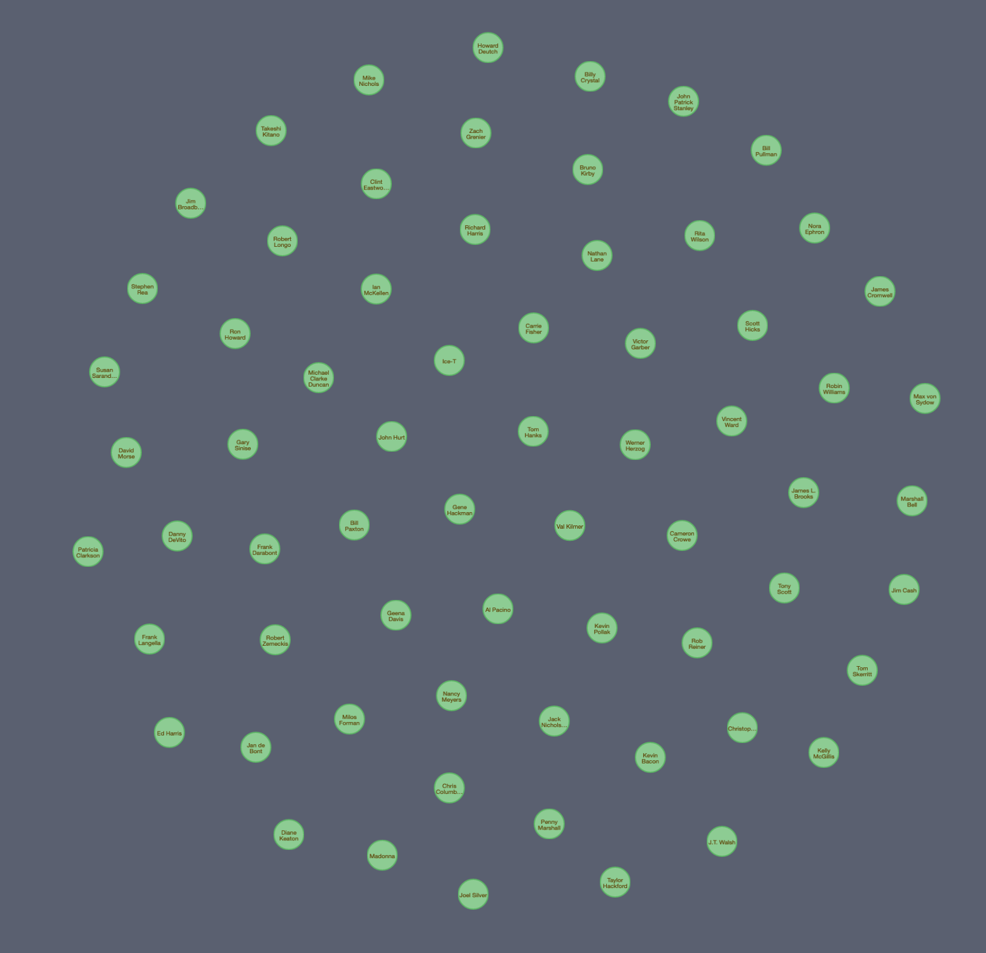
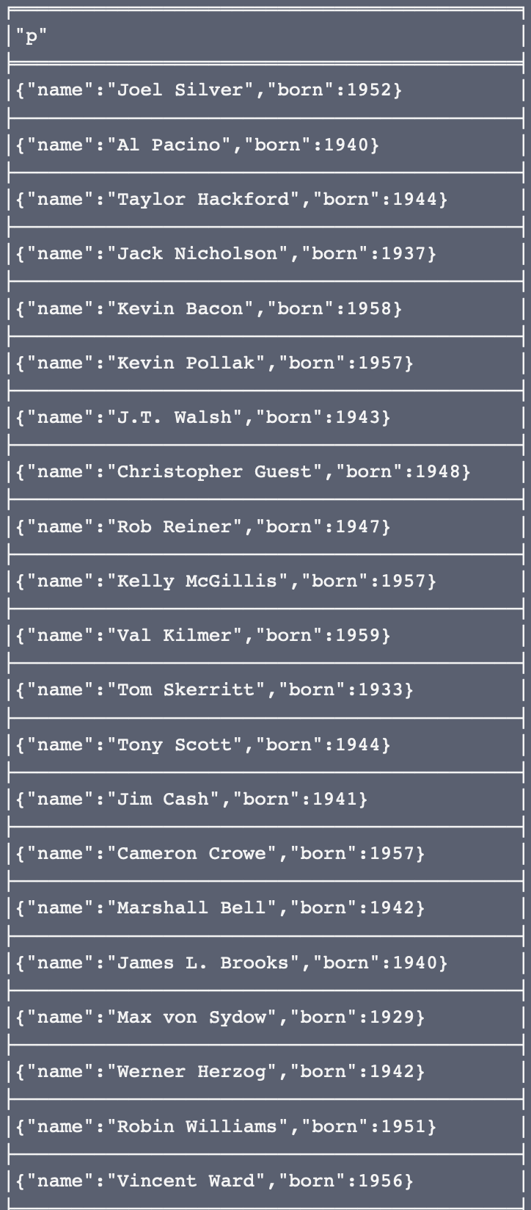
match (p:Person) where p.born < 1960 return p

Slide 35
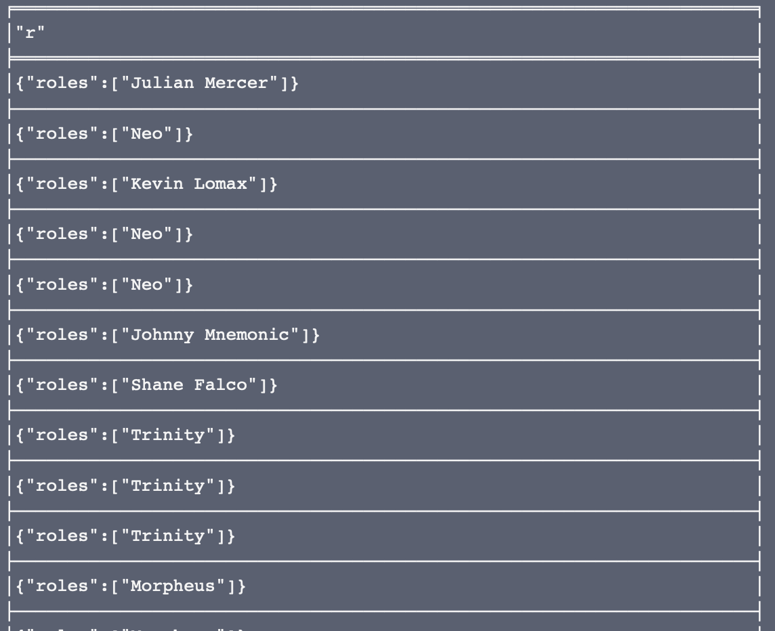
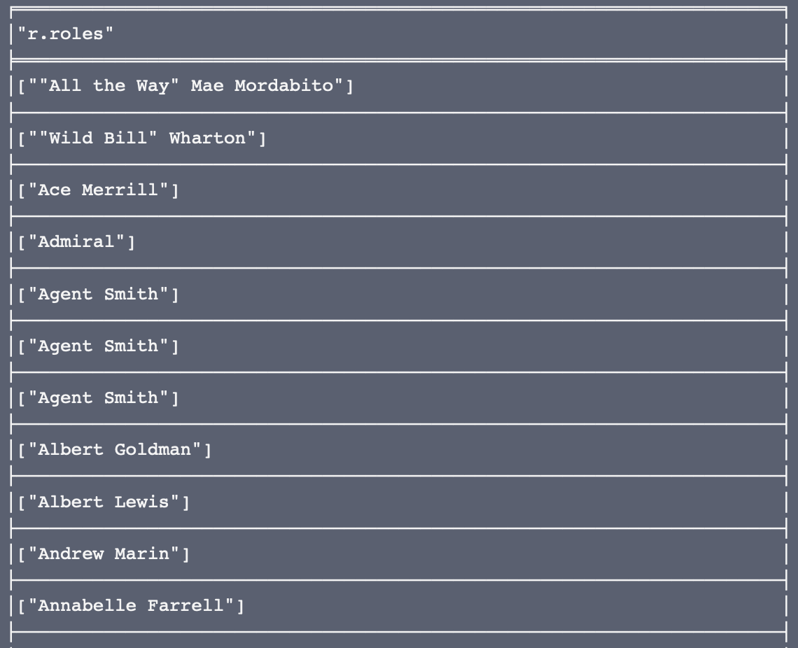
match (d:Person)-[r:ACTED_IN]->() return r
match (d:Person)-[r:ACTED_IN]->() return r.roles order by r.roles

Slide 36
match (d:Person)-[r:ACTED_IN]->() return r
match (d:Person)-[r:ACTED_IN]->() return r.roles order by r.roles

Slide 37
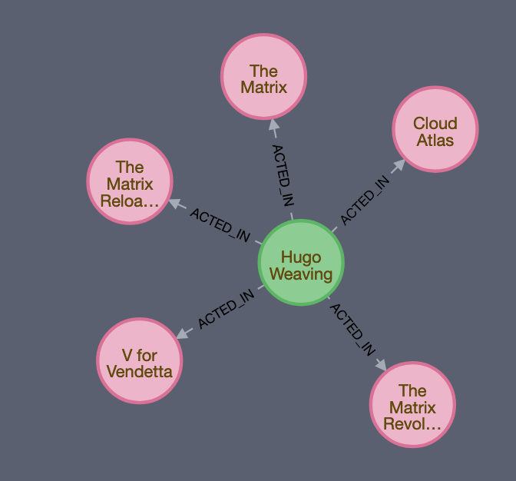
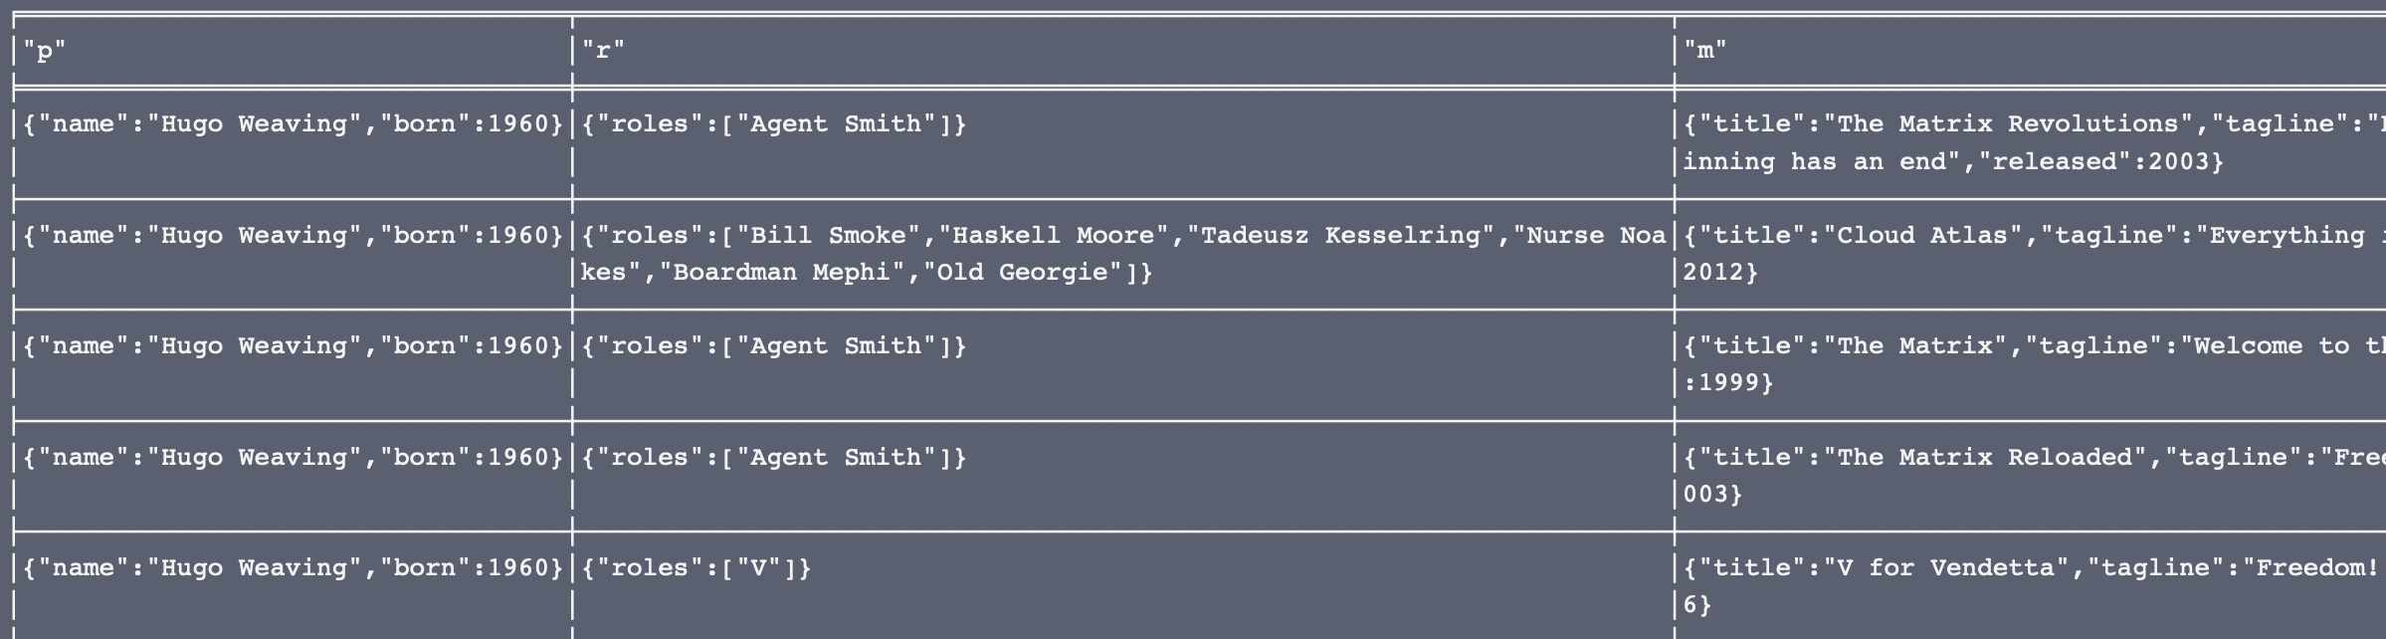
match (p:Person {name: “Hugo Weaving”})-[r:ACTED_IN]->(m:Movie) return p, r, m
DISTINCT

Slide 38
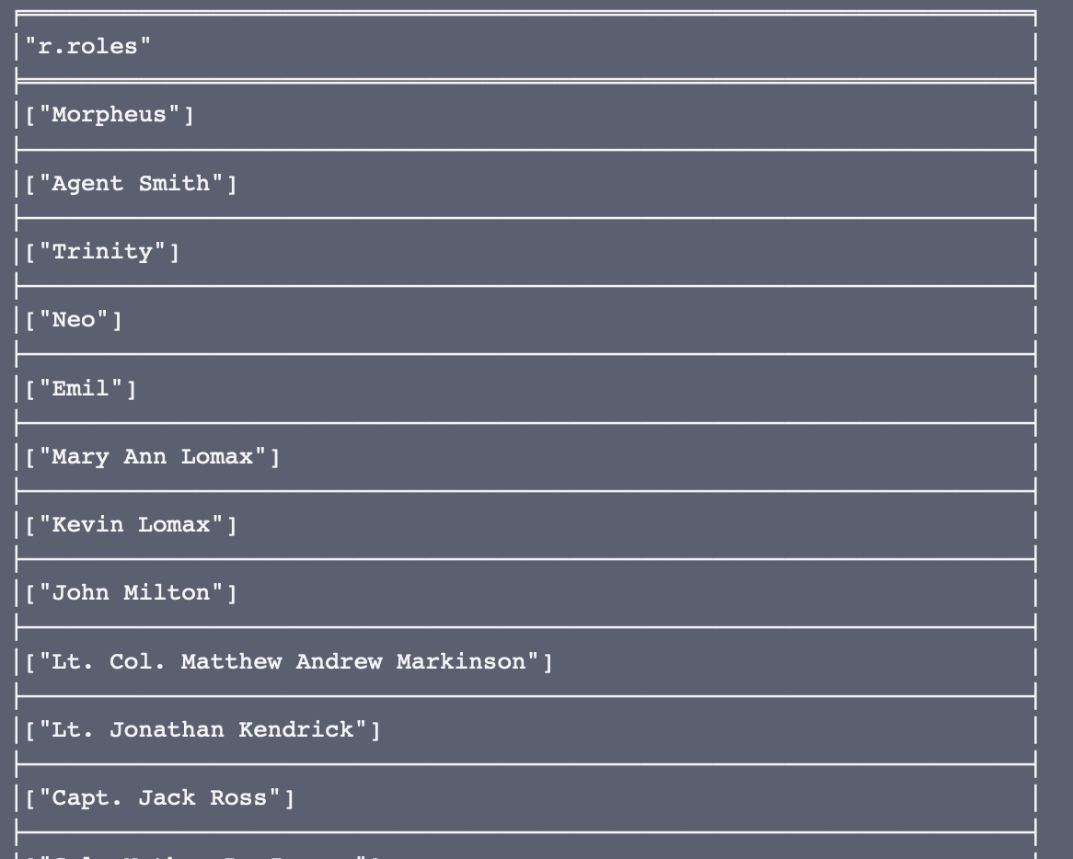
match (p:Person)-[r:ACTED_IN]->() return distinct r.roles
DISTINCT

Slide 39
match (p:Person) where p.born < 1960 return count(p)
Aggregation Functions
match (p:Person) where p.born < 1960 return avg(p.born)
match (p:Person) where p.born < 1960 return min(p.born)

Slide 40
CREATE
temporary label for query
CREATE (shakespeare:Author {firstname:'William', lastname:'Shakespeare'}),
(juliusCaesar:Play {title:'Julius Caesar'}),
(shakespeare)-[:WROTE_PLAY {year:1599}]->(juliusCaesar),
(theTempest:Play {title:'The Tempest'}),
(shakespeare)-[:WROTE_PLAY {year:1610}]->(theTempest)
shorthand
shorthand

Slide 41
CREATE CONSTRAINT / INDEX ON
CREATE CONSTRAINT ON (p:Play) ASSERT p.title IS UNIQUE
Means for limiting insertion of duplicated data
CREATE INDEX ON :Person(name)
Allows for direct access to nodes for starting queries, otherwise would need to traverse entire graph

Slide 42
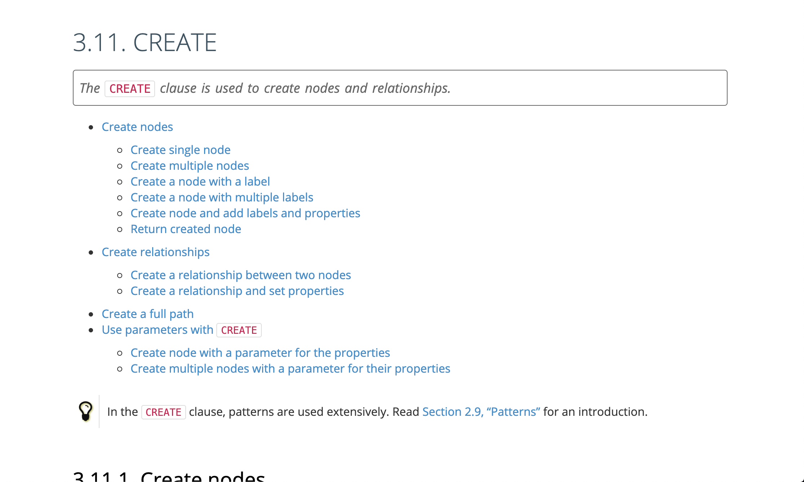
https://neo4j.com/docs/cypher-manual/current/clauses/create/

Slide 43
SET
MATCH (a:Author {firstname: 'William'})
SET a.firstname = 'Billy', a.eyecolor = 'blue'
RETURN a

Slide 44
DELETE
MATCH (tom:Person {name: “Tom Hanks”}) DELETE tom
Match to delete specific nodes
MATCH (tom:Person {name: “Tom Hanks”}) DETACH DELETE tom
Delete node and relationships it is a part of

Slide 45
Graphs and Relational Tables
Person
Movies and People
People ”acted in” or “directed” movies
How to convert to a relation?
ACTED_IN
DIRECTED
Movie

Slide 46
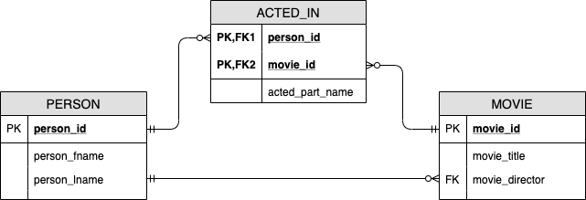
Graphs and Relational Tables

Slide 47
Graphs and Relational Tables

Slide 48
Graphs and Relational Tables

Slide 49
Graphs and Relational Tables

Slide 50
Graphs and Relational Tables

Slide 51
Graph Modeling Basics
Common nouns in domain description become entity (node) labels
Verbs usually represent object relationships. However, think about the nature of the verb (“Verbing”).
“Charlotte emailed José” is a verb with an implicit object so it is actually “Charlotte sent an email to José”
(charlotte)-[:EMAILED]->(jose)
(charlotte)-[:SENT]->(email)-[:TO]->(jose)

Slide 52
Graph Modeling Basics
Proper nouns are described through the properties of a labeled node
(p:Person {name: “Eric”}) instead of (e:Eric)
Figure out what types of questions you want to ask of the database to see if paths are obvious.
Relationships describe how entities are related, try not to encode entities into relationships.

Slide 53
Graph Modeling Basics
Things -> Entities -> Nodes
Verbs -> Relationships -> Connections
Node properties represent the attributes of a particular thing.
Relationship properties ”express the strength, weight, or quality of a relationship” along with relationship metadata

